Slide 1


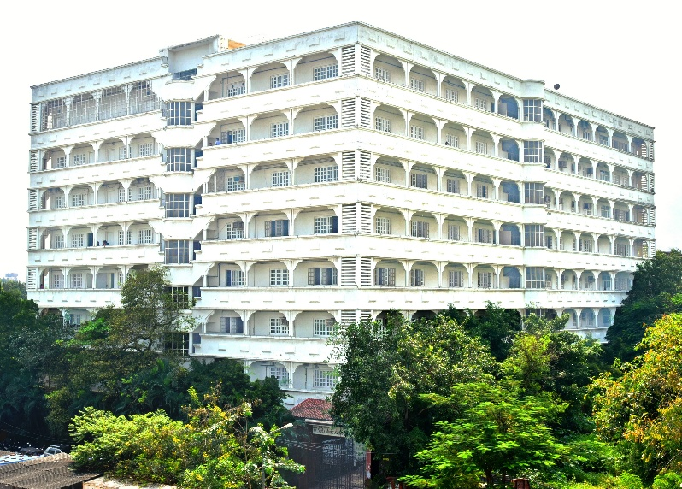
Mahavir Education Trust’s Shah & Anchor Kutchhi Engineering College Chembur, Mumbai-400088 (An Autonomous Institute Affiliated to University of Mumbai)
Department of Cyber Security
presentation
on
Multilayer Switches
(Subject: Operating Systems, CSCOR1PC201, III Semester)

Slide 2
Vision & Mission
Institute Vision
Department Vision
To be a globally recognized department that provides quality education in cybersecurity, promotes ethical practices, and prepares professionals to tackle real world challenges.
To become a globally recognized institution offering quality education and enhancing professional standards
Institute Mission
Department Mission
To impart high quality technical education to the students by providing an excellent academic environment, well - equipped laboratories and training through motivated teachers.
1. To deliver high-quality cybersecurity value-based education and enhancing the teaching-learning process for professional excellence.
2. To promote research, industry collaboration and entrepreneurship to address global challenges in cybersecurity.

Slide 3
Program Specific Outcomes
Index | Outcome
PSO1 | Cybersecurity graduates will understand evolving threats and vulnerabilities in both software and hardware within the field of cybersecurity.
PSO2 | Cybersecurity graduates will demonstrate the ability to ethically use tools and technologies to develop innovative solutions while balancing security, privacy, and law enforcement needs.

Slide 4
Outline
Prepare an 8–10 slide PowerPoint presentation covering:
Title
Problem Statement
Background
Working Principle
Architecture / Diagram
Demonstration
Real-Time Application
SDG Mapping
Conclusion
References

Slide 5

Multilayer Switches in Data Centers
A High-Speed Solution for Inter-VLAN Routing and Network Performance
COMPUTER NETWORKS
CISCO PACKET TRACER
Made by Stuti Shah
SYCS_53
PRN: 125BTCS1057

Slide 6

The Problem We're Solving
The Challenge
Modern data centers require high-speed communication between multiple departments while maintaining security and scalability. Traditional Layer 2 switches cannot route traffic between VLANs, and deploying separate routers introduces cost, complexity, and latency.
Project Objective
Design, analyze, and demonstrate a multilayer switching solution that delivers efficient Inter-VLAN Routing with improved performance, scalability, and security — all within a single device.

Slide 7
What Is a Multilayer Switch?
A multilayer switch combines Layer 2 and Layer 3 functionality in one device — eliminating the need for a separate router in many enterprise scenarios.
Layer 2 Switching
Layer 3 Routing
Forwards frames based on MAC addresses within the same VLAN.
Routes packets using IP addresses across different
VLANs.
Inter-VLAN Routing
Hardware-Based
Enables communication between VLANs without an external router.
ASIC-based forwarding delivers wire-speed performance.

Slide 8

Working Principle
When a packet arrives, the multilayer switch inspects both the MAC and IP addresses to determine whether to
switch or route.
Device Sends
Inspect MAC & IP
Layer 3 Route
Forward to VLAN
If the destination is local, the frame is switched at Layer 2. If it belongs to another VLAN, the switch routes it through the appropriate Switch Virtual Interface (SVI).

Slide 9
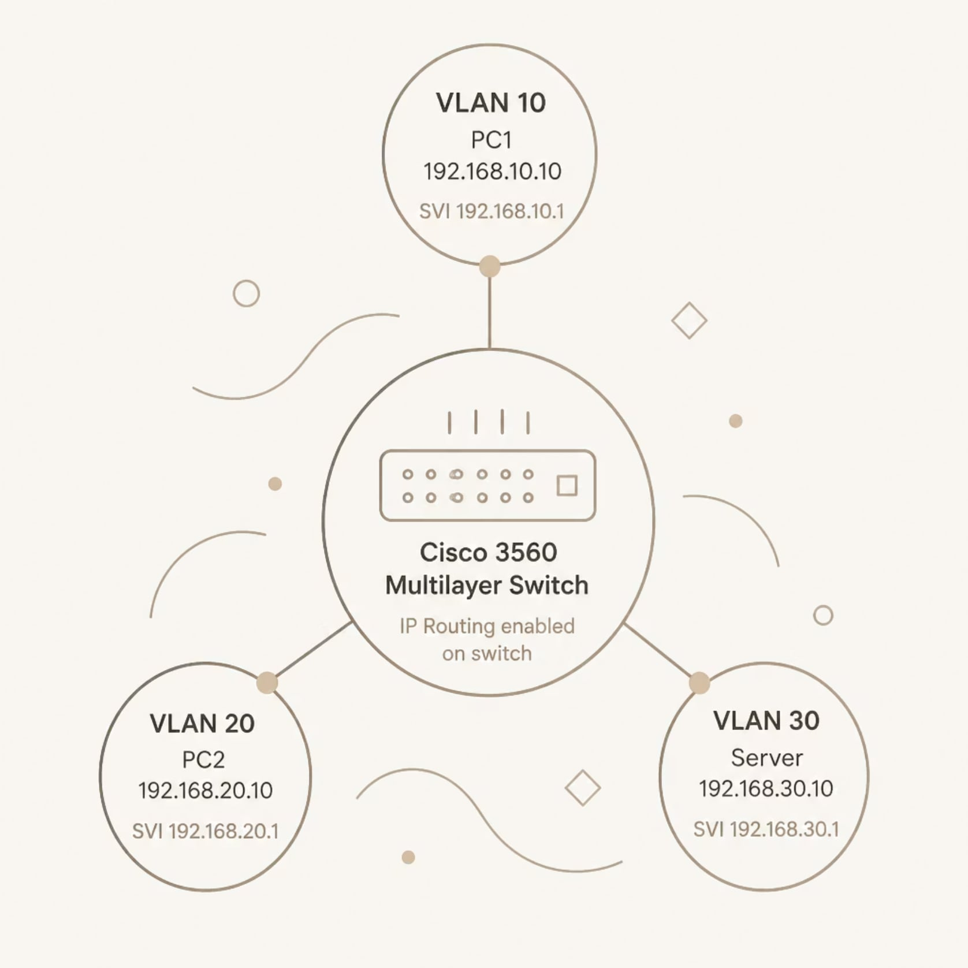

Network Architecture
Cisco 3560 Multilayer Switch
The switch acts as the central routing and switching hub. Each VLAN has a dedicated Switch Virtual Interface (SVI) that serves as the default gateway for all devices in that VLAN.
VLAN 10 — PC1 (192.168.10.10), Gateway: 192.168.10.1
VLAN 20 — PC2 (192.168.20.10), Gateway: 192.168.20.1
VLAN 30 — Server (192.168.30.10), Gateway: 192.168.30.1
IP Routing must be explicitly enabled on the switch for
Inter-VLAN communication.

Slide 10
Practical Demonstration
Using Cisco Packet Tracer, the following configuration was implemented and verified step by step.
01
02
03
Create VLANs 10, 20, and 30
Assign Switch Ports
Configure SVIs
Defined VLANs on the Cisco
3560 switch.
Assigned access ports to each
VLAN.
Created Switch Virtual Interfaces with IP addresses as default gateways.
04
05
Enable IP Routing
Verify with Ping
Activated Layer 3 routing with ip routing.
Confirmed successful Inter-VLAN communication between all devices.

Slide 11
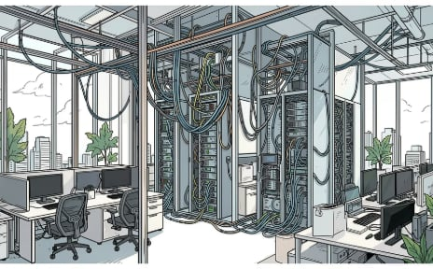

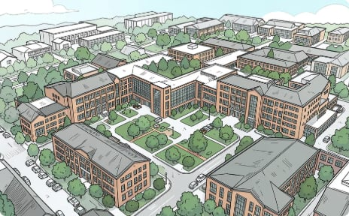
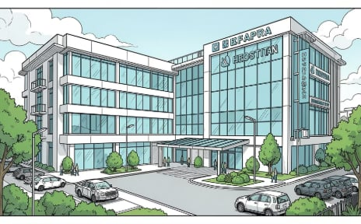
Real-World Applications
Multilayer switches are deployed wherever high-performance, segmented networking is required.
Enterprise Networks
Data Centers
Campus & Universities
Hospitals & Cloud
Connect departments securely while maintaining performance.
Route traffic between server VLANs at wire speed.
Segment academic, administrative, and guest networks.
Isolate critical systems and support cloud infrastructure.

Slide 12
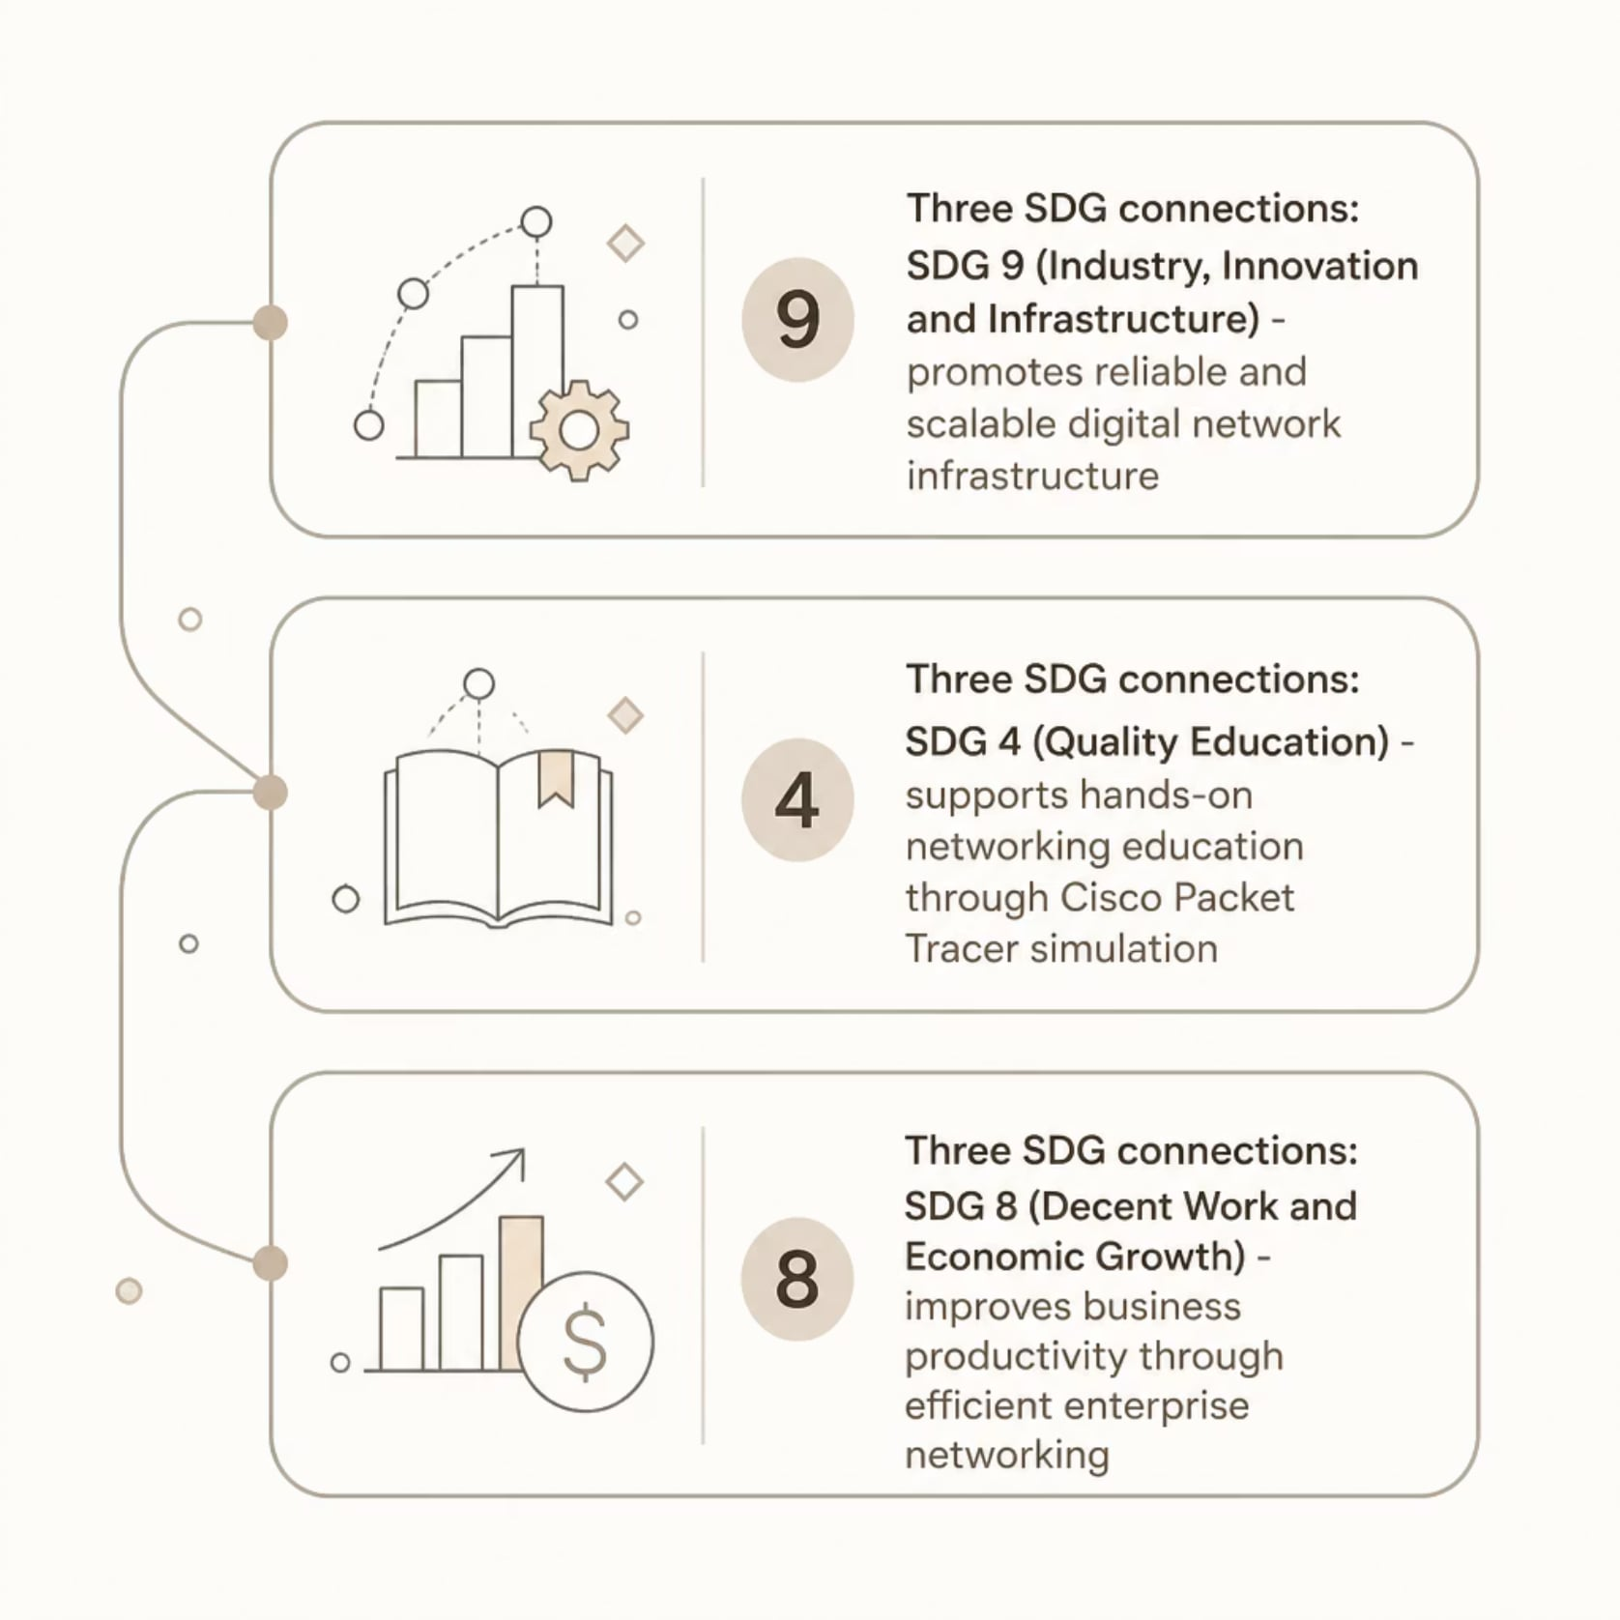
Alignment with Sustainable
Development Goals (SDG)
Why This Matters
This project connects networking education and practice to broader global goals — demonstrating that technical solutions can drive social and economic progress.

Slide 13

Conclusion
Unified Functionality
Combines Layer 2 switching and Layer 3 routing in a single device — no external router required.
High-Speed Inter-VLAN Routing
Hardware-based routing dramatically reduces latency compared to router-on-a-stick designs.
Scalable & Secure
VLAN segmentation with SVI-based routing supports growing enterprise and data center environments.
Proven in Simulation
Cisco Packet Tracer successfully demonstrated end-to-end Inter-VLAN communication across three VLANs.

Slide 14

References
1
Cisco Networking Academy
Switching, Routing and Wireless Essentials
2
Cisco Catalyst 3560 Guide
Official Configuration Guide
3
Cisco Packet Tracer
User Guide and Simulation Platform
4
Kurose & Ross
Computer Networking: A Top-Down Approach
5
Cisco Learning Network
VLANs and Inter-VLAN Routing Resources
All configurations and demonstrations were validated using Cisco Packet Tracer in alignment with Cisco
Networking Academy curriculum standards.

Slide 15

Thank You

